Slide 1
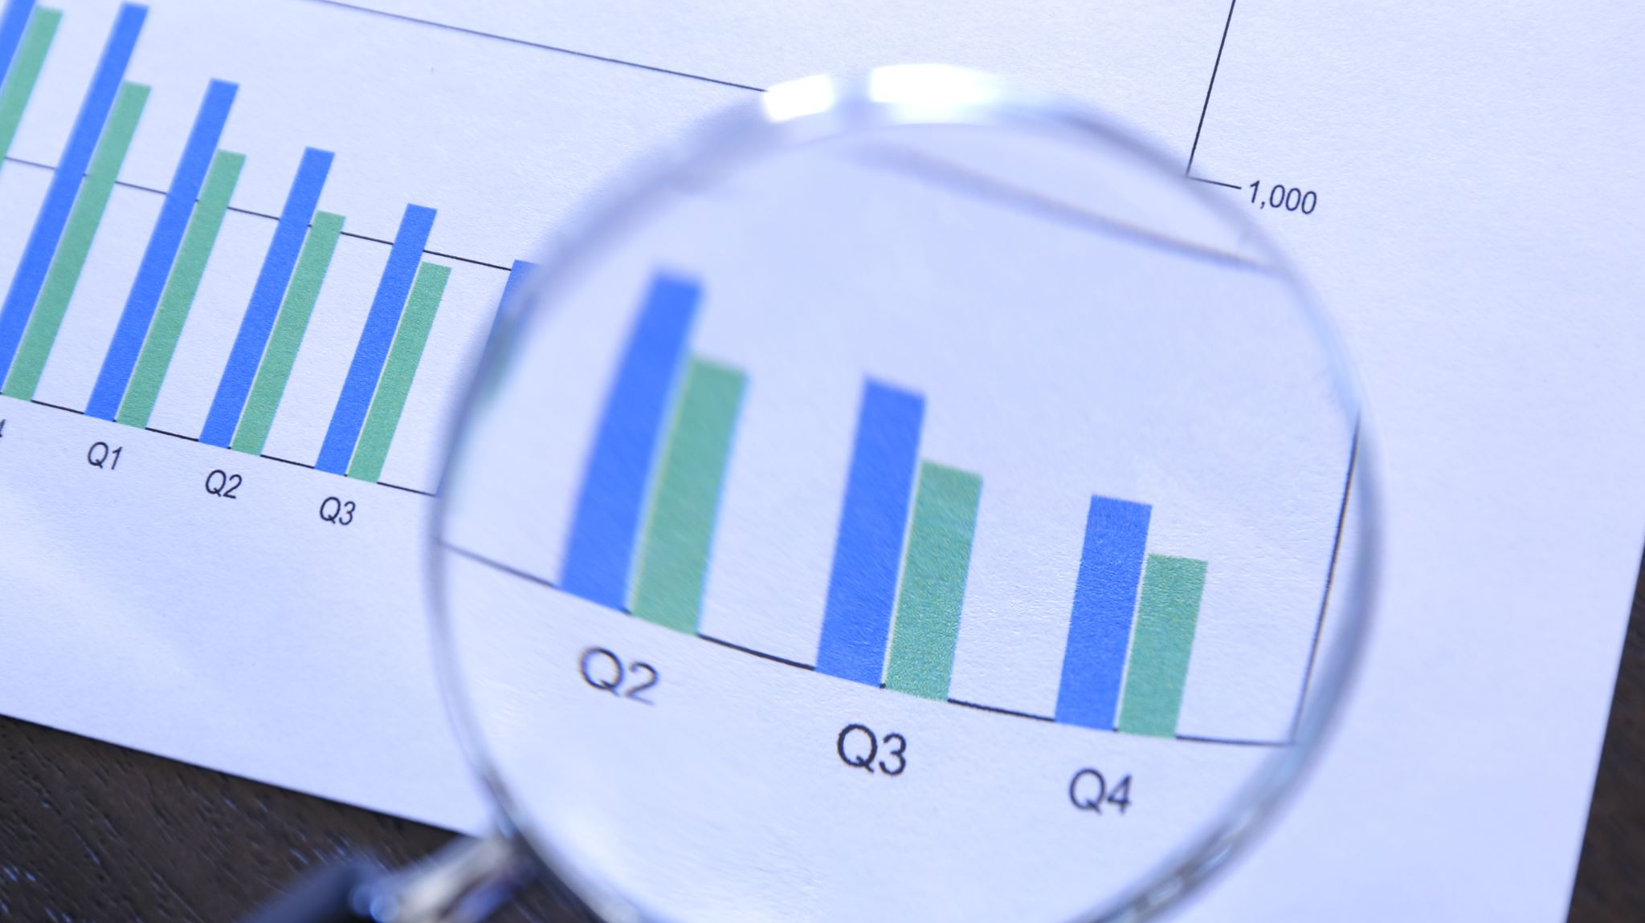
Data Analysis Cycle

Slide 2
Example Scenario
Customer segmentation is the practice of splitting a customer base into groups of individuals who share similar characteristics
Categories could include age, gender, income, interests or spending habits
How is this useful?
Notes:
For this presentation we will be exploring customer segmentation in retail
Customer segmentation is the practice of splitting a customer base into groups of individuals who share similar characteristics
Categories could include age, gender, income, interests or spending habits
How can some of this information can be used to make business decisions in a retail environment?

Slide 3
How would you start?
Pick a hypothesis
What do we want to achieve or learn?
“Is there a correlation between consumer age and income?”
H0 = “There is no correlation between consumer age and income”
H1 = “There is a positive correlation between consumer age and income”
Notes:
We need to decide on a hypothesis to test
What do we want to achieve or learn?
A way to better inform our business decisions that provides us with insight into the spending habits of customers
“Is there a correlation between consumer age and income?”
This could highlight the different spending powers of customers and how best to target goods and promotions at those with greater potential disposable income
H0 = “There is no correlation between consumer age and income”
H1 = “There is a positive correlation between consumer age and income”

Slide 4
How would you obtain the data?
Surveying at a physical location
Online surveys
Customer loyalty schemes and company databases
For this example we will be using a simulated dataset of a retail membership card scheme
This was obtained from kaggle.com, as a .csv file
Notes:
If we were to obtain the data from scratch perhaps it could be gathered by surveying customers at a physical store location
Alternatively through online surveys or data obtained via customer loyalty programs
Real world surveys are probably less efficient these days but may offer access to different demographics and datapoints
Online surveys allow the casting of a wider net
Customer loyalty may be the best choice for this study, probably quite a good representation of the whole consumer base
For this example we will be using a simulated dataset of a retail membership card scheme
This was obtained from kaggle.com, as a .csv file

Slide 5
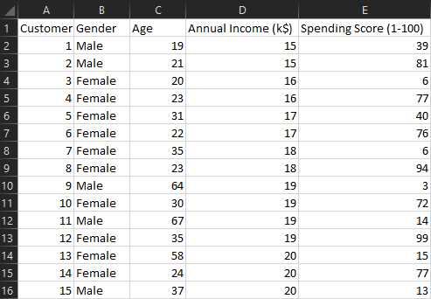
Small sample from dataset
Notes:
The dataset contained information for 200 customers
Covering gender, age, annual income and spending score
(a value assigned to customers based on their spending habits and behaviours)

Slide 6
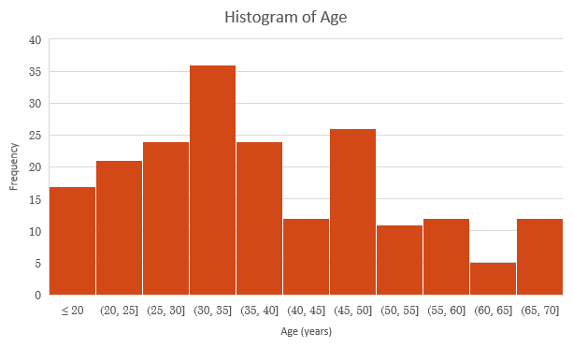
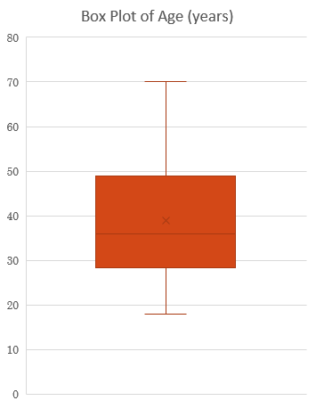
Consumer Age
 | Age (years)
Mean | 38.85
Median | 36
Mode | 32
Variance | 195.13
Std. Dev | 13.97
Range | 52
Midrange | 44
Notes:
Box plot gives us a visual representation of a lot of different information
The box is drawn from Q1 to Q3
The horizontal line shows the median
The “x” shows the mean
The whiskers are drawn outwards to the maximum and minimum values, showing the range
Histogram shows us the frequency of customers in different age brackets
Skews a bit left towards a slightly younger market
Averages are below midrange
Std. dev is quite high

Slide 7
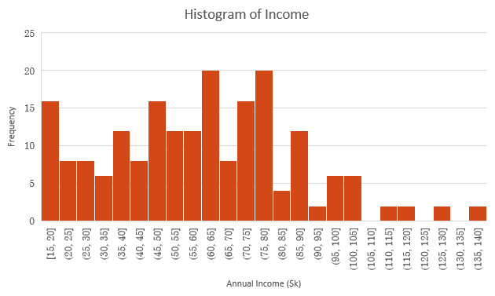
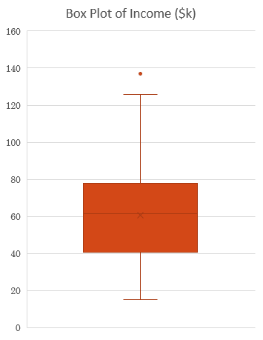
Consumer Income
 | Income ($k)
Mean | 60.56
Median | 61.5
Mode | 54
Variance | 689.84
Std. Dev | 26.26
Range | 122
Midrange | 76
Notes:
Box plot gives us a visual representation of a lot of different information
The box is drawn from Q1 to Q3
The horizontal line shows the median
The “x” shows the mean
The whiskers are drawn outwards to the maximum and minimum values, showing the range
Histogram shows us the frequency of customers in different annual income brackets
Skews a bit left towards a slightly lower income than the midrange
Averages are below midrange
Std. dev is quite high
Comparison to national income data, are certain demographics better represented in this consumer base?

Slide 8
Consumer Age & Income
 | Age (years) | Income ($k)
Mean | 38.85 | 60.56
Median | 36 | 61.5
Mode | 32 | 54
Variance | 195.13 | 689.84
Std. Dev | 13.97 | 26.26
Range | 52 | 122
Midrange | 44 | 76

Slide 9
What can we learn?
There is no strong corelation between consumer age and income
At 1σ:
Average age range is 24.9-52.8 years
Average income range is $34.3k-$86.8k
The standard deviation is reasonably large
Observing the scatter plot it can be seen that outlying higher income figures do drop off with an increase in age

Slide 10
Development of the data
Further customer segmentation
More extensive datapoints to allow further classification
Segmenting by gender, education level, loyalty (how long they’ve been a membership card holder), frequency of shopping trips, marital status, dependents, pet ownership, etc.
Notes:
Future study could provide better insights by further segmenting consumers
Additional datasets including more extensive datapoints to allow further classification
Segmenting by gender, education level, loyalty (how long they’ve been a membership card holder), frequency of shopping trips, marital status, dependents, etc.

Slide 11
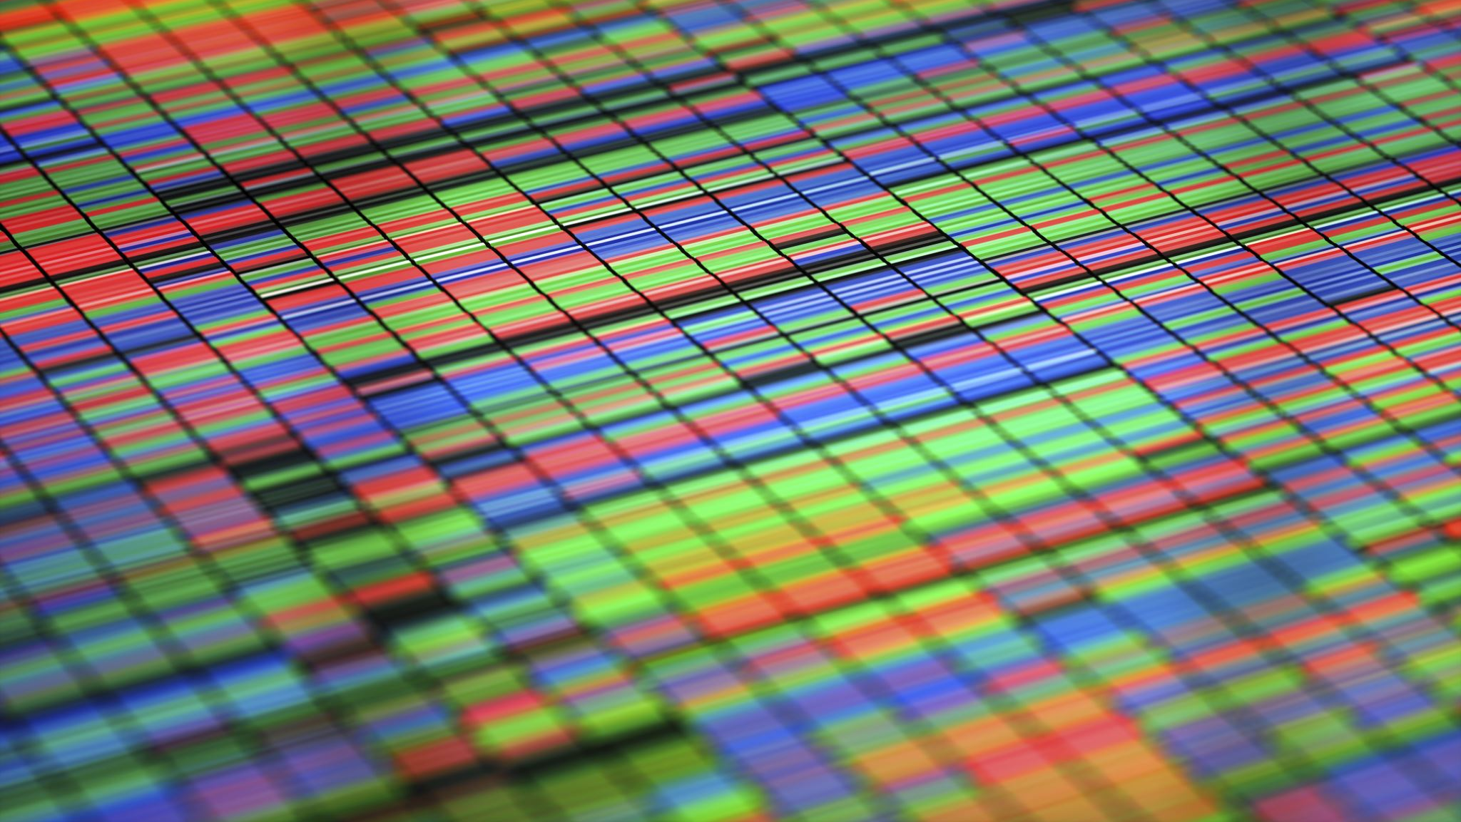
Probability & Statistics

Slide 12

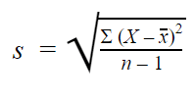
Standard Deviation
Standard deviation (σ) is a measure of average variability in a dataset
It represents how far each datapoint lies from the mean on average
The smaller the σ value, the more closely values are clustered near the population or sample mean
σ = population standard deviation
s = sample standard deviation
∑ = sum of
X = each value
μ = population mean
x̅ = sample mean
N = number of values in the population
n = number of values in the sample
Population SD
Sample SD
Notes:
Standard deviation (σ) is a measure of average variability in a dataset
It represents how far each datapoint lies from the mean on average
The smaller the σ value, the more closely values are clustered near the population or sample mean
***reveal***
Here you can see the equations for calculating standard deviation of a population or a sample
***talk through it***

Slide 13
Pros and Cons of Standard Deviation
Advantages
Limitations
Easy to intuitively understand (unlike variance)
More accurate than other measures of variability (like MAD)
Shows the average spread of data
Similar to but more complex to calculate than MAD (Mean Average Distribution)
Sensitive to outlier values on account of squaring them during calculation

Slide 14
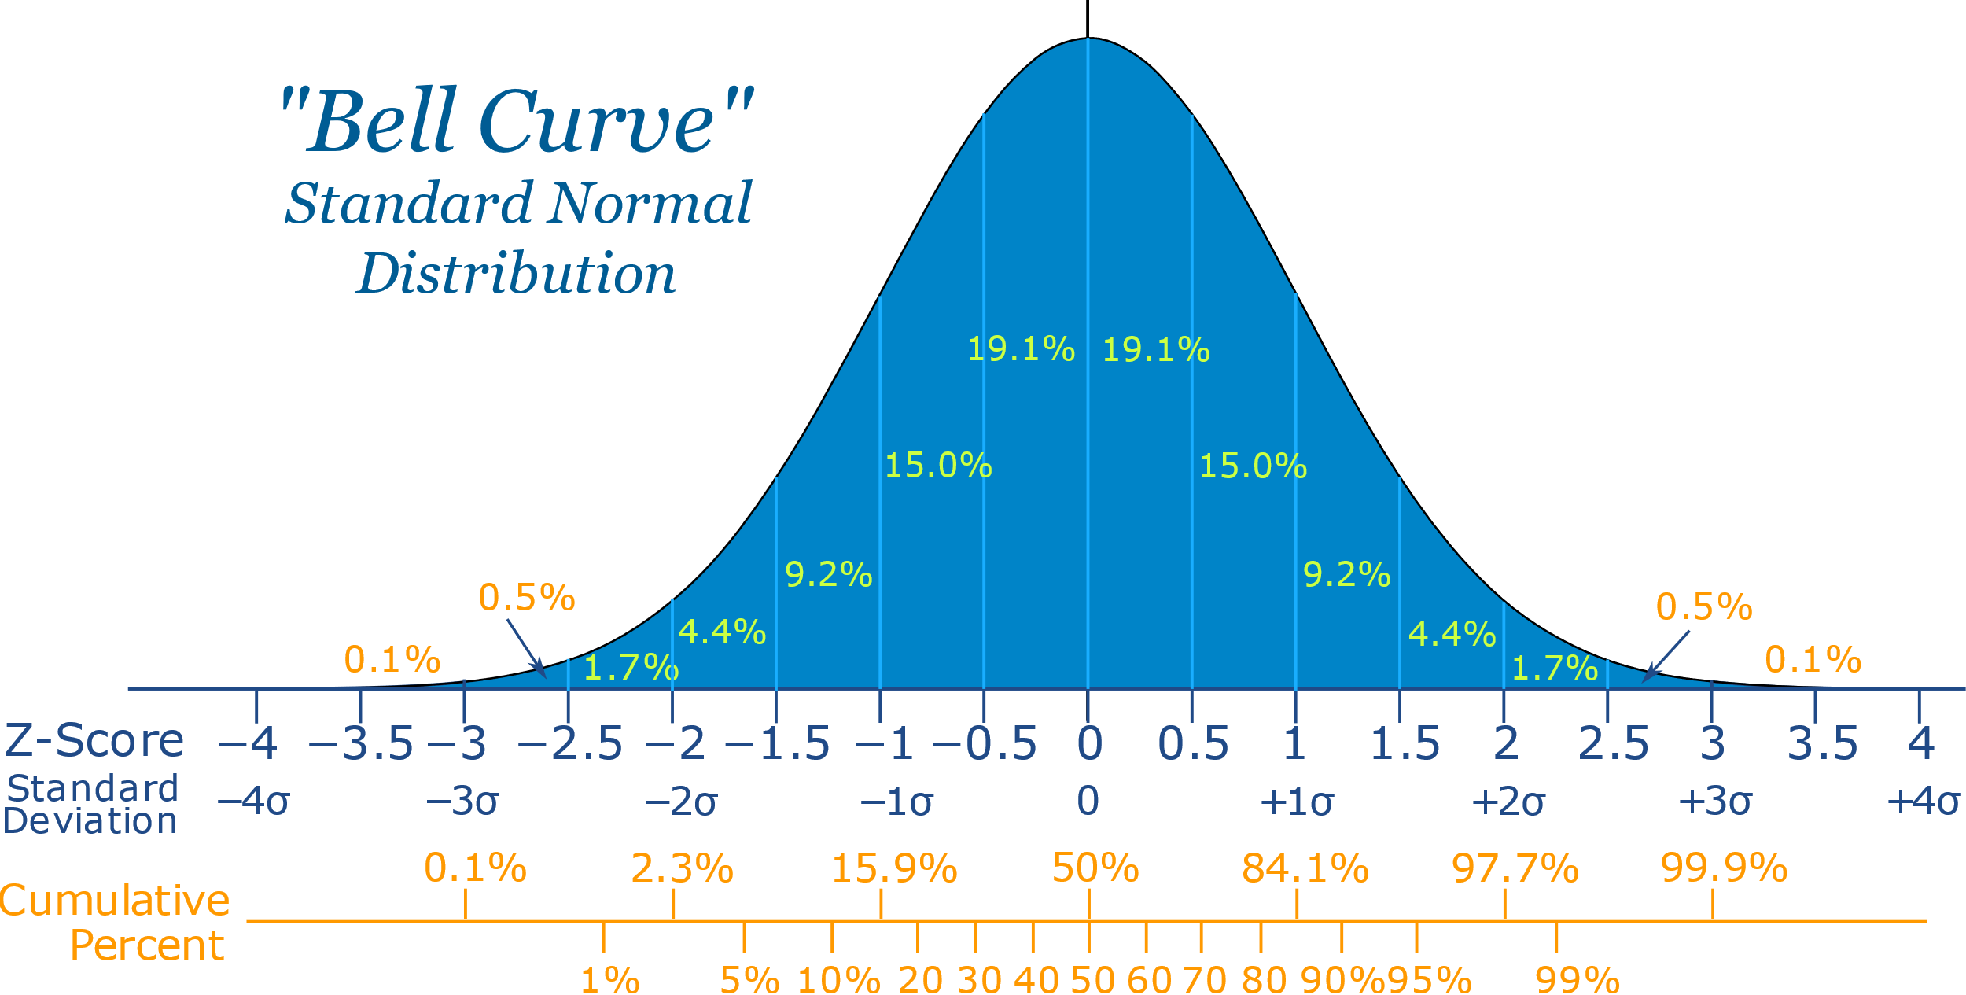
Normal Distribution
Also known as a Bell curve or Gaussian distribution
A variable which follows this curve is said to be normally distributed
1σ = 68.3%
2σ = 95.4%
3σ = 99.7%
Notes:
Also known as a Bell curve or Gaussian distribution
A variable which follows this curve is said to be normally distributed
Here is a graph showing the normal distribution
***Reveal***
Symmetrical
Empirical rule

Slide 15
Central Limit Theorem
Central limit theorem (CLT) states that the distribution of a sample variable approximates a normal distribution as the sample size becomes larger, assuming that all samples are identical in size, and regardless of the population's actual distribution shape
Typically requires sample sizes of at least 30 to prove true
The standard deviations and means of samples will equate to that of the population
A sample of appropriately large size can predict the characteristics of an entire population
Notes:
Central limit theorem (CLT) states that the distribution of a sample variable approximates a normal distribution as the sample size becomes larger, assuming that all samples are identical in size, and regardless of the population's actual distribution shape
Typically requires sample sizes of at least 30 to prove true
The standard deviations and means of samples will equate to that of the population
A sample of appropriately large size can predict the characteristics of an entire population

Slide 16
Key components of CLT
Sampling is Successive
Sampling should not exclude samples used on previous occasions
Sampling is Random
All samples must have the same probability of being selected
Sampling should be Independent
Results from one sample shouldn’t impact other samples
Samples should be Limited
Often said that sample should be no more than 10% of population
Notes:
Sampling is Successive
Sampling should not exclude samples used on previous occasions
Sampling is Random
All samples must have the same probability of being selected
Sampling should be Independent
Results from one sample shouldn’t impact other samples
Samples should be Limited
Often said that sample should be no more than 10% of population

Slide 17
Thank You

